Slide 1


I Project Presentation (KCS 753) (Codeforces Analyser)
KIET Group of Institutions, Ghaziabad
(An ISO – 9001: 2008 Certified & ‘A+’ Grade accredited Institution by NAAC)
Guide Name: Prof. Sreesh Gaur
Project Members Name with Roll Number & Section
1. Priyanshi, 2000290120117, CS 7B
2. Priyanshu Raj, 2000290120119, CS 7B
3.Sagar Srivastava, 2000290111038, CS7B

Slide 2
Problem Statement
To make a fully functional dynamic website to keep a track of complete happenings of Codeforces platform.
To ease the tracking and analyses of skills acquired along with the growth undertaken in a simplified and user friendly manner.
In addition, it seeks to address and resolve the following issues:-
Limited user Profile Insights
Difficulty in comparing User Profiles
Lack of Peak performance Analysis

Slide 3
Objectives
The primary objective of the Codeforces Analyser project is to create a user-friendly analytics and visualization platform that leverages the Codeforces API to enable users to:
Visualize and understand their competitive programming journey on Codeforces.
Analyse their performance trends, including rating history and contest participation.
Compare their Codeforces profiles with those of other users.
Identify areas for improvement and set performance goals.
Track and visualize their highest positive rating achieved over time.
In essence, this project aims to enhance the Codeforces user experience by providing valuable insights, encouraging healthy competition, and fostering a sense of community among competitive programmers on the platform.

Slide 4
Technology Used
Domain of the Project :- Full Stack Development
Front end :- HTML,CSS, JavaScript, ReactJS
Backend :-Google Charts, MySQL, MDL
Version Control :- GitHub
Testing:- Jest

Slide 5
Literature Survey
Paper Title: Codeforces Analyser using API Integration
Author name: Smith, J., & Brown, A.
Journal Name: "Enhancing Learning Experience through Coding Platforms: A User-Centric Perspective
Year of publishing: 2019
Followed by Summary of papers:
The paper consisted on the the details about how a responsive web design could be created. Responsive web design is a technique that allows a website to adapt to the device where a page is loading or being accessed , such as a desktop, laptop, tablet or smartphone. It uses flexible layouts and aims to provide a better user experience, accessibility and performance for web pages across different devices.

Slide 6
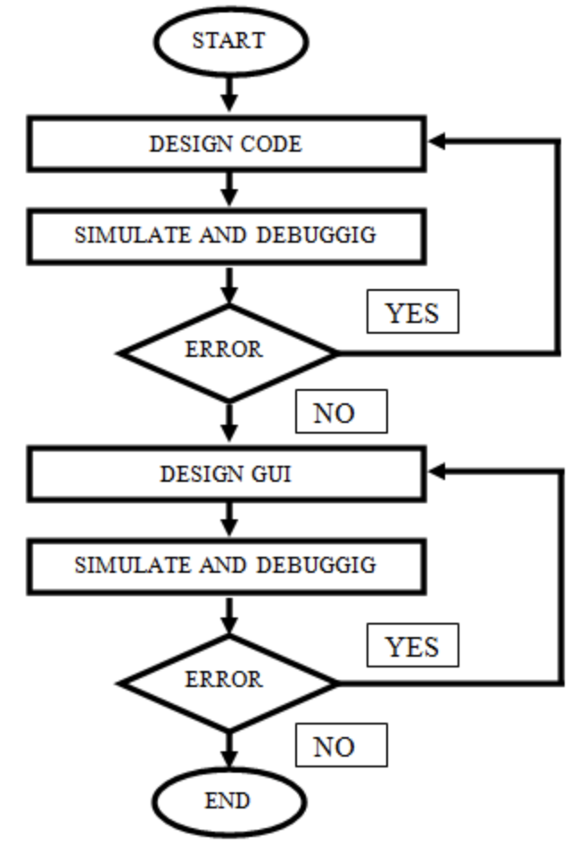
Workflow Diagram:-

Slide 7
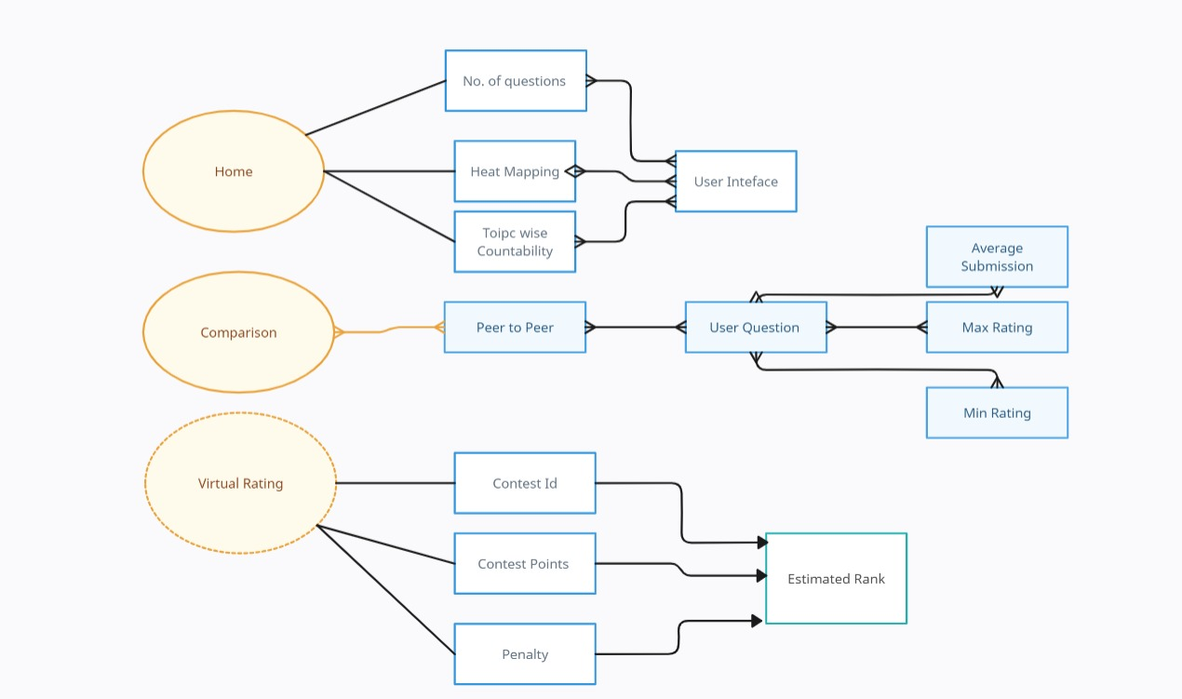
ER Diagram

Slide 8

Patent Status

Slide 9
Research Paper Status
Draft completion status: 100%
Draft approved by project guide

Slide 10
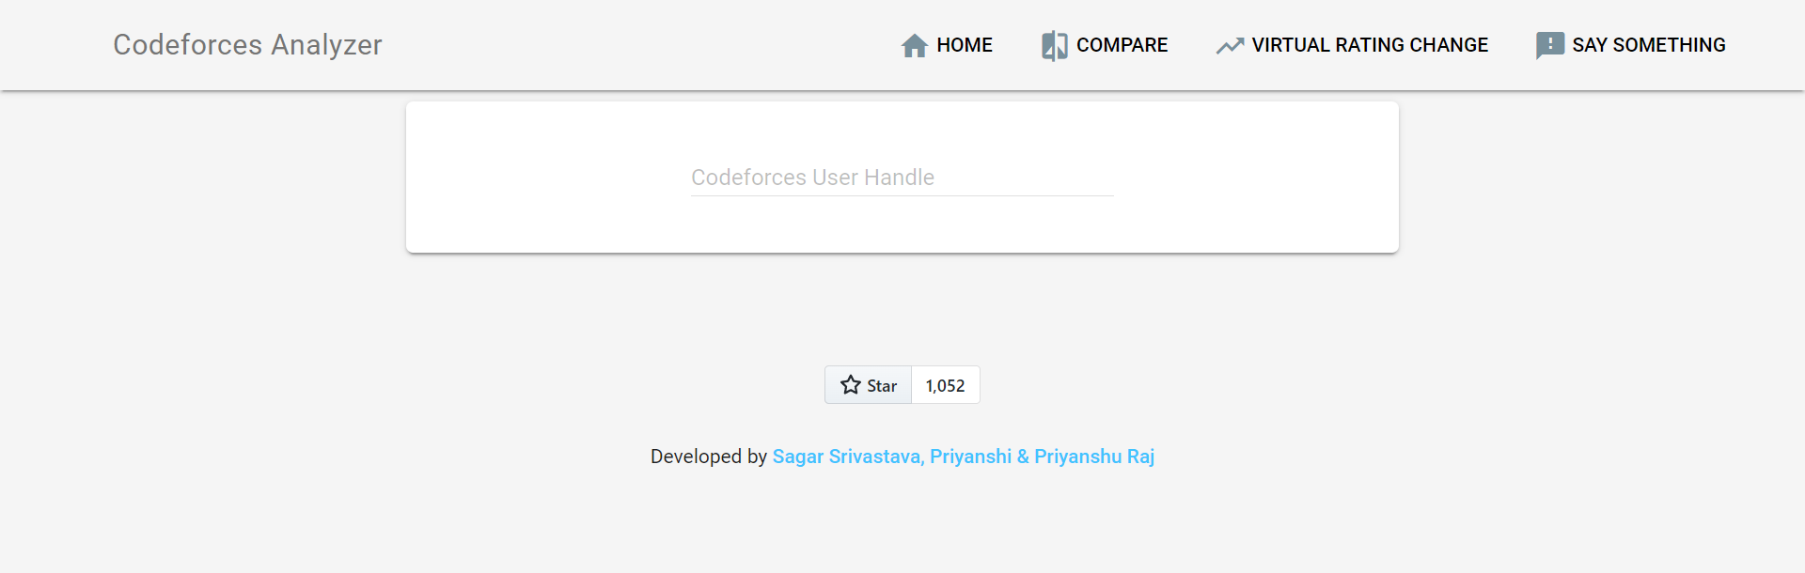
Project Status
Project completed successfully, achieving all objectives.
Working of project with the help of Screenshots:-

Slide 11
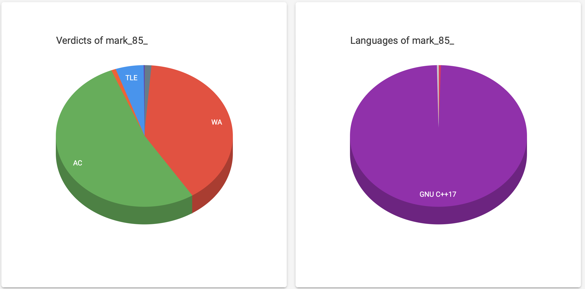
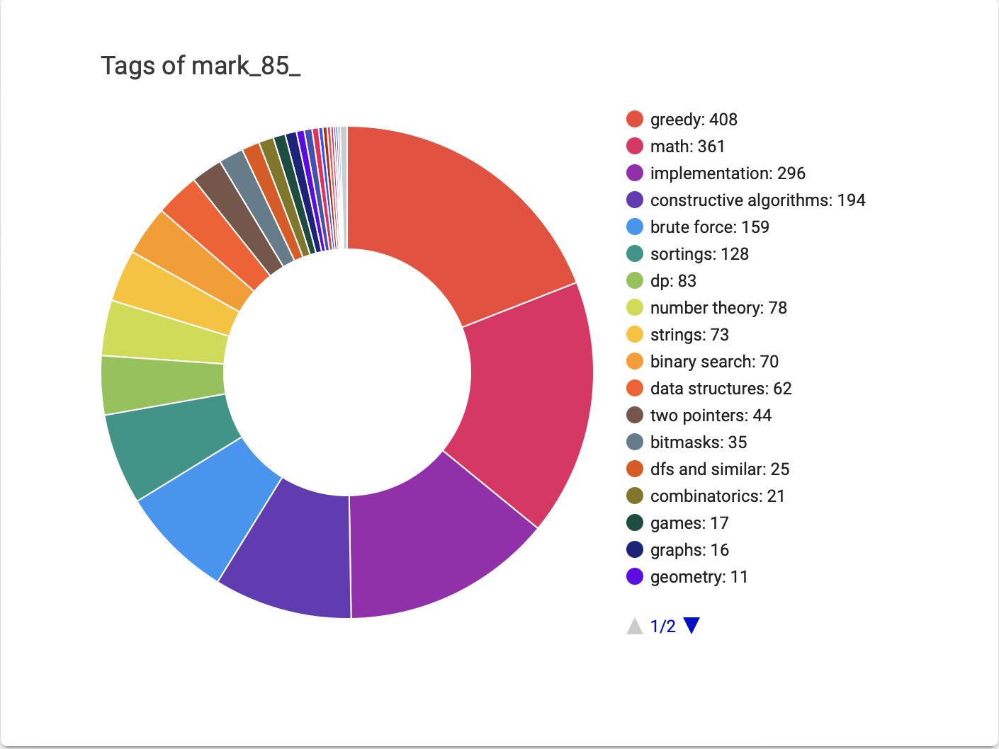
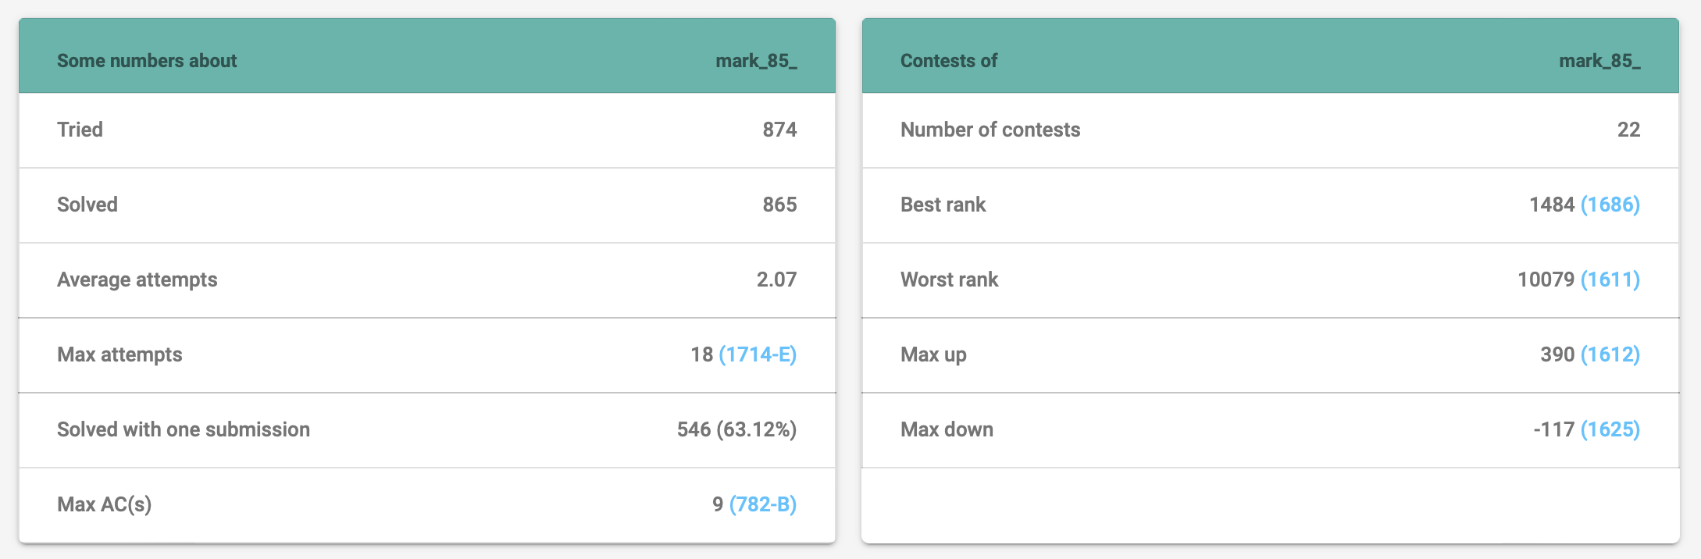

Slide 12
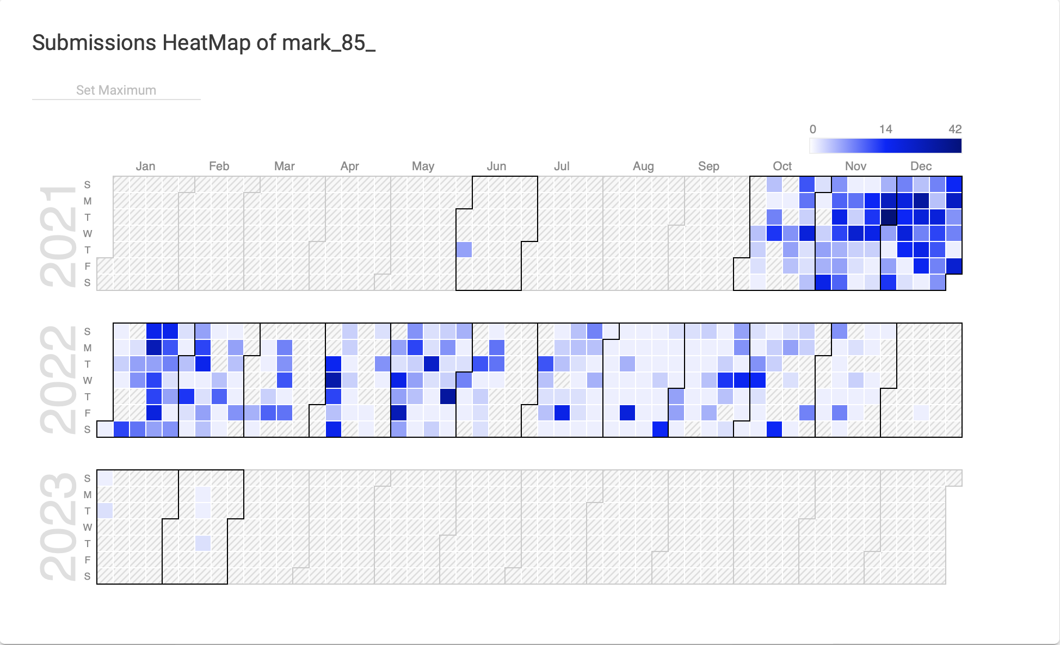

Slide 13
References
A. N. S. S. Vybhavi, L. V. Saroja, J. Duvvuru and J. Bayana,
"Video Transcript Summarizer," 2022
International Mobile and Embedded Technology Conference (MECON), 2022, pp. 461-465, doi:
10.1109/MECON53876.2022.9751991
P. Choudhary, S. P. Munukutla, K. S. Rajesh and A. S. Shukla, "Real time video summarization on mobile platform," 2017 IEEE International Conference on Multimedia and Expo (ICME), 2017, pp. 1045-1050, doi: 10.1109/ICME.2017.8019530
Ying Li, Shih-Hung Lee, Chia-Hung Yeh and C.. -C. J. Kuo, "Techniques for movie content analysis and skimming: tutorial and overview on video abstraction techniques," in IEEE Signal Processing Magazine, vol. 23, no. 2, pp. 79-89, March 2006, doi: 10.1109/MSP.2006.1621451.
Yu-Fei Ma, Xian-Sheng Hua, Lie Lu and Hong-Jiang Zhang, "A generic framework of user attention model and its application in video summarization," in IEEE Transactions on Multimedia, vol. 7, no. 5, pp.
907-919, Oct. 2005, doi: 10.1109/TMM.2005.854410

